Slide 1

8051 ASSEMBLY
LANGUAGE
PROGRAMMING
Embedded Systems: Using Assembly and C
Dr. Qamaruddin Memon
Dept. of Software Engineering
Bahria University, Karachi Campus

Slide 2
Embedded Systems: Using Assembly and C
Dr. Qamaruddin Memon

Slide 3

‰ The flag bits affected by the ADD
instruction are CY, P, AC, and OV
Example 2-2
FLAG BITS AND
PSW REGISTER
ADD
Instruction And
Show the status of the CY, AC and P flag after the addition of 38H
and 2FH in the following instructions.
PSW
MOV A, #38H
(cont’)
ADD A, #2FH ;after the addition A=67H, CY=0
Solution:
38
+ 2F
67
00111000
00101111
01100111
CY = 0 since there is no carry beyond the D7 bit
AC = 1 since there is a carry from the D3 to the D4 bi
P = 1 since the accumulator has an odd number of 1s (it has five 1s)
HANEL
31

Slide 4

FLAG BITS AND
PSW REGISTER
Example 2-3
Show the status of the CY, AC and P flag after the addition of 9CH
and 64H in the following instructions.
ADD
Instruction And
MOV A, #9CH
ADD A, #64H ;after the addition A=00H, CY=1
PSW
Solution:
(cont’)
9C
+ 64
100
10011100
01100100
00000000
CY = 1 since there is a carry beyond the D7 bit
AC = 1 since there is a carry from the D3 to the D4 bi
P = 0 since the accumulator has an even number of 1s (it has zero 1s)
HANEL
32

Slide 5

FLAG BITS AND
PSW REGISTER
Example 2-4
Show the status of the CY, AC and P flag after the addition of 88H
and 93H in the following instructions.
ADD
Instruction And
MOV A, #88H
ADD A, #93H ;after the addition A=1BH, CY=1
PSW
Solution:
(cont’)
88
+ 93
11B
10001000
10010011
00011011
CY = 1 since there is a carry beyond the D7 bit
AC = 0 since there is no carry from the D3 to the D4 bi
P = 0 since the accumulator has an even number of 1s (it has four 1s)
HANEL
33

Slide 6

‰ There are 128 bytes of RAM in the
8051
 Assigned addresses 00 to 7FH
‰ The 128 bytes are divided into three
different groups as follows:
REGISTER
BANKS AND
STACK
RAM Memory
Space
1)
A total of 32 bytes from locations 00 to
1F hex are set aside for register banks
and the stack
Allocation
2) A total of 16 bytes from locations 20H to
2FH are set aside for bit-addressable
read/write memory
3) A total of 80 bytes from locations 30H to
7FH are used for read and write storage,
called scratch pad
HANEL
34

Slide 7

RAM Allocation in 8051
8051
7F
REGISTER
BANKS AND
STACK
Scratch pad RAM
30
2F
Bit-Addressable RAM
Register Bank 3
RAM Memory
Space
20
1F
Allocation
(cont’)
18
17
10
0F
Register Bank 2
Register Bank 1 (stack)
08
07
Register Bank 0
00
HANEL
35

Slide 8
‰ These 32 bytes are divided into 4
banks of registers in which each bank
has 8 registers, R0-R7
8051
REGISTER
BANKS AND
STACK

RAM location from 0 to 7 are set aside for
bank 0 of R0-R7 where R0 is RAM location
0, R1 is RAM location 1, R2 is RAM
location 2, and so on, until memory
location 7 which belongs to R7 of bank 0
Register Banks
 It is much easier to refer to these RAM
locations with names such as R0, R1, and
so on, than by their memory locations
‰ Register bank 0 is the default when
8051 is powered up
HANEL
36

Slide 9

8051
Register banks and their RAM address
REGISTER
BANKS AND
STACK
Bank 0
Bank 1
Bank 2
Bank 3
7
6
5
R7
R6
R5
R4
R3
R2
R1
R0
F
E
D
R7
R6
R5
R4
R3
R2
R1
R0
17
16
15
R7
R6
R5
R4
R3
R2
R1
R0
1F
1E
1D
R7
R6
R5
R4
R3
R2
R1
R0
Register Banks
(cont’)
4
3
2
1
C
B
A
9
14
13
12
11
1C
1B
1A
19
0
8
10
18
HANEL
37

Slide 10

‰ We can switch to other banks by use
of the PSW register
8051
REGISTER
BANKS AND
STACK

Bits D4 and D3 of the PSW are used to
select the desired register bank
 Use the bit-addressable instructions SETB
Register Banks
and CLR to access PSW.4 and PSW.3
(cont’)
PSW bank selection
RS1(PSW.4) RS0(PSW.3)
Bank 0
Bank 1
Bank 2
Bank 3
0
0
1
1
0
1
0
1
HANEL
38

Slide 11

8051
Example 2-5
MOV R0, #99H ;load R0 with 99H
MOV R1, #85H ;load R1 with 85H
REGISTER
BANKS AND
STACK
Example 2-6
Register Banks MOV 00, #99H ;RAM location 00H has 99H
(cont’)
MOV 01, #85H ;RAM location 01H has 85H
Example 2-7
SETB PSW.4
;select bank 2
MOV R0, #99H ;RAM location 10H has 99H
MOV R1, #85H ;RAM location 11H has 85H
HANEL
39

Slide 12
‰ The stack is a section of RAM used by
the CPU to store information
temporarily
8051
REGISTER
BANKS AND
STACK
 This information could be data or an
address
The register used to access the stack
is called the SP (stack pointer) register
Stack
‰
 The stack pointer in the 8051 is only 8 bit
wide, which means that it can take value
of 00 to FFH
 When the 8051 is powered up, the SP
register contains value 07
ƒ RAM location 08 is the first location begin used
for the stack by the 8051
HANEL
40

Slide 13
‰ The storing of a CPU register in the
stack is called a PUSH
8051
REGISTER
BANKS AND
STACK

SP is pointing to the last used location of
the stack
 As we push data onto the stack, the SP is
incremented by one
Stack
(cont’)
ƒ This is different from many microprocessors
‰ Loading the contents of the stack back
into a CPU register is called a POP
 With every pop, the top byte of the stack
is copied to the register specified by the
instruction and the stack pointer is
decremented once
HANEL
41

Slide 14
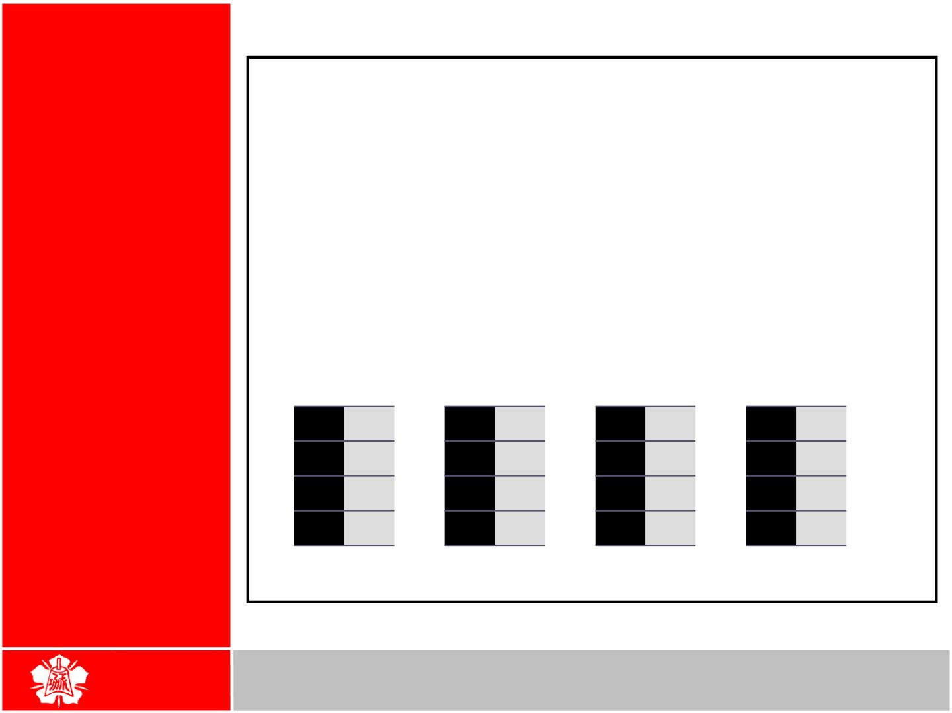
8051
Example 2-8
REGISTER
BANKS AND
STACK
Show the stack and stack pointer from the following. Assume the
default stack area.
MOV R6, #25H
MOV R1, #12H
MOV R4, #0F3H
PUSH 6
PUSH 1
PUSH 4
Pushing onto
Stack
Solution:
After PUSH 6 After PUSH 1 After PUSH 4
0B
0A
09
08
0B
0B
0B
0A
0A
0A F3
09 12
08 25
SP = 0A
09
09 12
08 25
SP = 09
08 25
Start SP = 07 SP = 08
HANEL
42

Slide 15
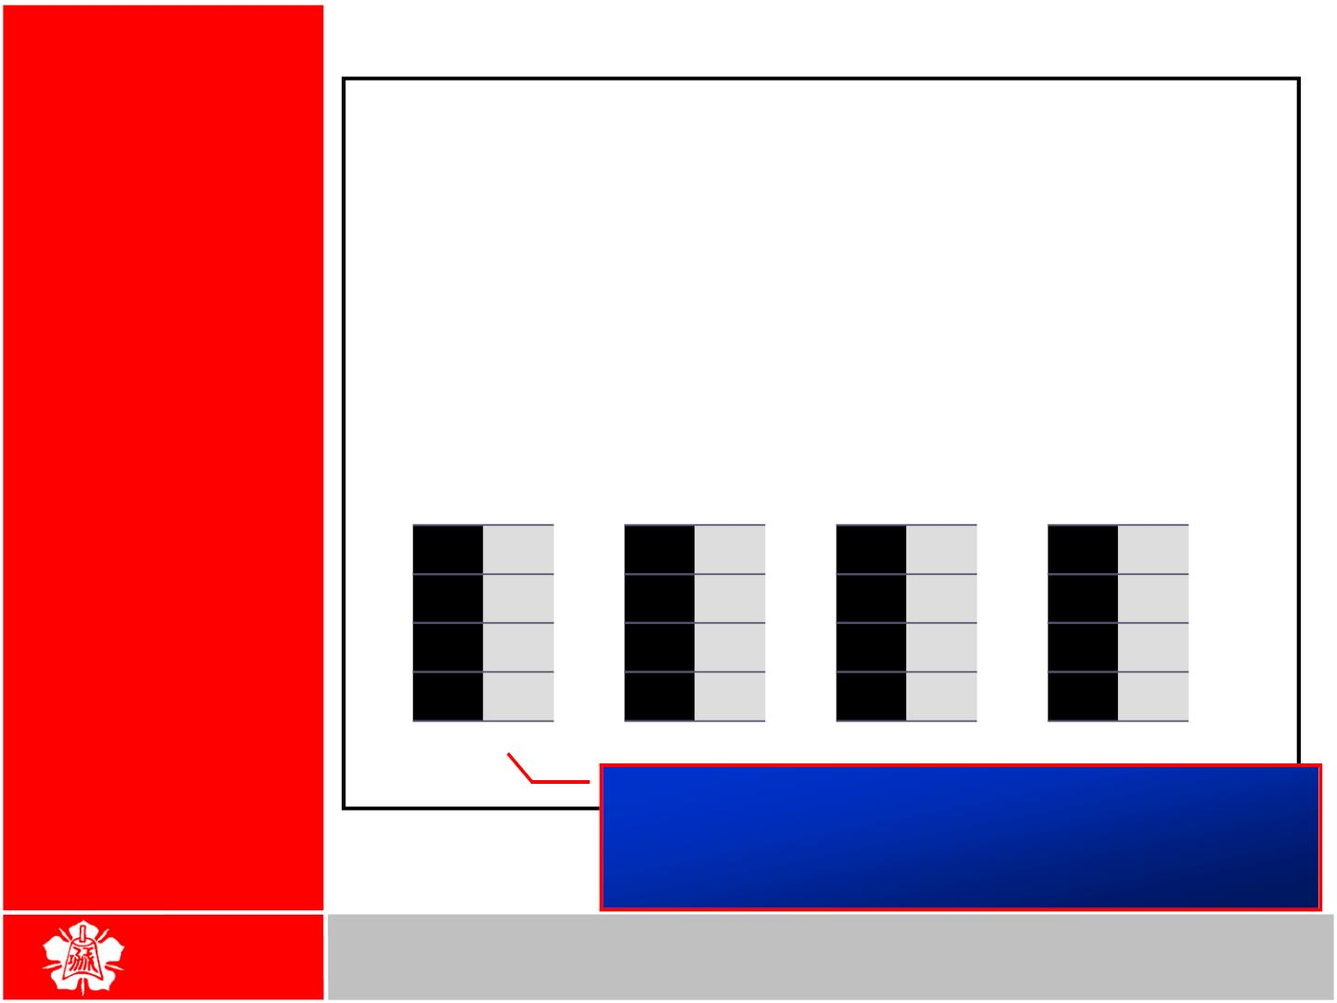
8051
Example 2-9
REGISTER
BANKS AND
STACK
Examining the stack, show the contents of the register and SP after
execution of the following instructions. All value are in hex.
POP
POP
POP
3
5
2
; POP stack into R3
; POP stack into R5
; POP stack into R2
Popping From
Stack
Solution:
After POP 3
After POP 5
0B
After POP 2
0B 54
0B
0B
0A F9
09 76
08 6C
0A F9
09 76
08 6C
0A
0A
09 76
08 6C
SP = 09
09
08 6C
Start SP = 0B SP = 0A
SP = 08
Because locations 20-2FH of RAM are reserved
for bit-addressable memory, so we can change the
SP to other RAM location by using the instruction
“MOV SP, #XX”
HANEL
Department of Computer Science and Information Engineering
National Cheng Kung University, TAIWAN
43

Slide 16
‰ The CPU also uses the stack to save
the address of the instruction just
below the CALLinstruction
8051
REGISTER
BANKS AND
STACK

This is how the CPU knows where to
resume when it returns from the called
subroutine
CALL
Instruction And
Stack
44

Slide 17
‰ The reason of incrementing SP after
push is
8051
REGISTER
BANKS AND
STACK

Make sure that the stack is growing
toward RAM location 7FH, from lower to
upper addresses
Incrementing
Stack Pointer
 Ensure that the stack will not reach the
bottom of RAM and consequently run out
of stack space
 If the stack pointer were decremented
after push
ƒ We would be using RAM locations 7, 6, 5, etc.
which belong to R7 to R0 of bank 0, the default
register bank
HANEL
45

Slide 18
‰ When 8051 is powered up, register
bank 1 and the stack are using the
same memory space
8051
REGISTER
BANKS AND
STACK

We can reallocate another section of RAM
to the stack
Stack and Bank
1 Conflict
HANEL
46

Slide 19
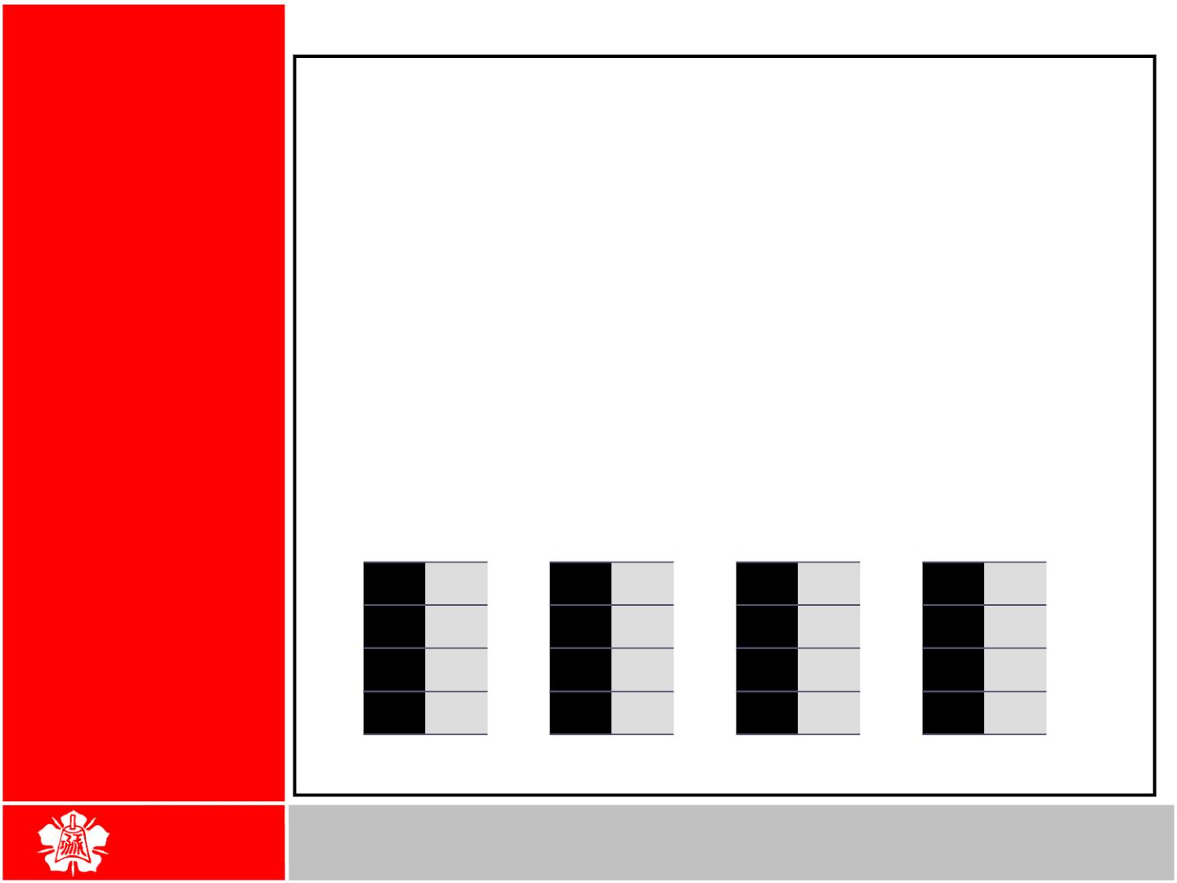
Example 2-10
8051
Examining the stack, show the contents of the register and SP after
execution of the following instructions. All value are in hex.
REGISTER
BANKS AND
STACK
MOV SP, #5FH
;make RAM location 60H
;first stack location
MOV R2, #25H
MOV R1, #12H
MOV R4, #0F3H
PUSH 2
PUSH 1
PUSH 4
Stack And Bank
1 Conflict
(cont’)
Solution:
After PUSH 2 After PUSH 1 After PUSH 4
63
62
61
60
63
63
63
62
62
62 F3
61 12
60 25
SP = 62
61
61 12
60 25
SP = 61
60 25
Start SP = 5F SP = 60
47

Slide 20

The CPU can access data in various ways, which are called addressing modes
  Immediate
  Register
ADDRESSING MODES
Direct
Register indirect
Indexed
Accessing memories
HANEL

Slide 21
The source operand is a constant
  The immediate data must be preceded by the pound sign, “#”
  Can load information into any registers, including 16-bit DPTR register
    DPTR can also be accessed as two 8-bit registers, the high byte DPH and low byte DPL
IMMEDIATE ADDRESSING MODE
MOV | A,#25H | ;load | 25H into A
MOV | R4,#62 | ;load | 62 into R4
MOV | B,#40H | ;load | 40H into B
MOV | DPTR,#4521H | ;DPTR=4512H
MOV | DPL,#21H | ;This is the same
MOV | DPH,#45H | ;as above
;illegal!! Value > 65535 (FFFFH) MOV DPTR,#68975
HANEL

Slide 22
We can use EQU directive to access immediate data
IMMEDIATE ADDRESSING MODE
(cont’)
Count | EQU 30
... MOV | ... R4,#COUNT | ;R4=1EH
MOV | DPTR,#MYDATA | ;DPTR=200H
ORG | 200H
MYDATA: DB | “America”
We can also use immediate addressing mode to send data to 8051 ports
MOV P1,#55H
HANEL

Slide 23
Use registers to hold the data to be manipulated
REGISTER ADDRESSING MODE
MOV A,R0 MOV R2,A ADD A,R5 ADD A,R7 MOV R6,A
;copy contents of R0 into A
;copy contents of A into R2
;add contents of R5 to A
;add contents of R7 to A
;save accumulator in R6
The source and destination registers must match in size
  MOV DPTR,A will give an error
MOV DPTR,#25F5H MOV R7,DPL
MOV R6,DPH
The movement of data between Rn registers is not allowed
  MOV R4,R7 is invalid
HANEL

Slide 24


It is most often used the direct addressing mode to access RAM locations 30 – 7FH
  The entire 128 bytes of RAM can be
ACCESSING MEMORY
Direct Addressing Mode
accessed
Direct addressing mode
The register bank locations are accessed by the register names
MOV A,4 MOV A,R4
;is same as
;which means copy R4 into A
Contrast this with immediate
addressing mode
Register addressing mode
There is no “#” sign in the operand
MOV R0,40H MOV 56H,A
;save content of 40H in R0
;save content of A in 56H
HANEL

Slide 25
The SFR (Special Function Register) can be accessed by their names or by their addresses
ACCESSING MEMORY
SFR Registers and Their Addresses
MOV 0E0H,#55H MOV A,#55h
MOV 0F0H,R0 MOV B,R0
;is the same as
;load 55H into A
;is the same as
;copy R0 into B
The SFR registers have addresses between 80H and FFH
  Not all the address space of 80 to FF is used by SFR
  The unused locations 80H to FFH are reserved and must not be used by the 8051 programmer
HANEL

Slide 26
ACCESSING MEMORY
Example 5-1
Write code to send 55H to ports P1 and P2, using
(a) their names (b) their addresses
Solution :
SFR Registers and Their Addresses (cont’)
(a) MOV A,#55H
MOV P1,A MOV P2,A
;A=55H
;P1=55H
;P2=55H
(b) From Table 5-1, P1 address=80H; P2 address=A0H
MOV A,#55H MOV 80H,A MOV 0A0H,A
;A=55H
;P1=55H
;P2=55H
HANEL

